Slide 1
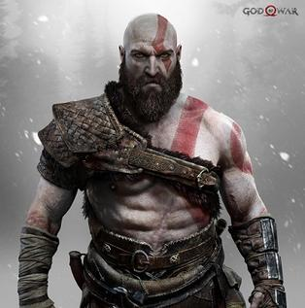
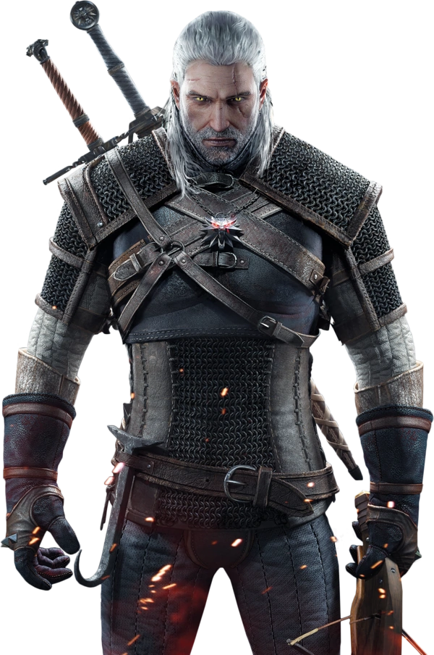
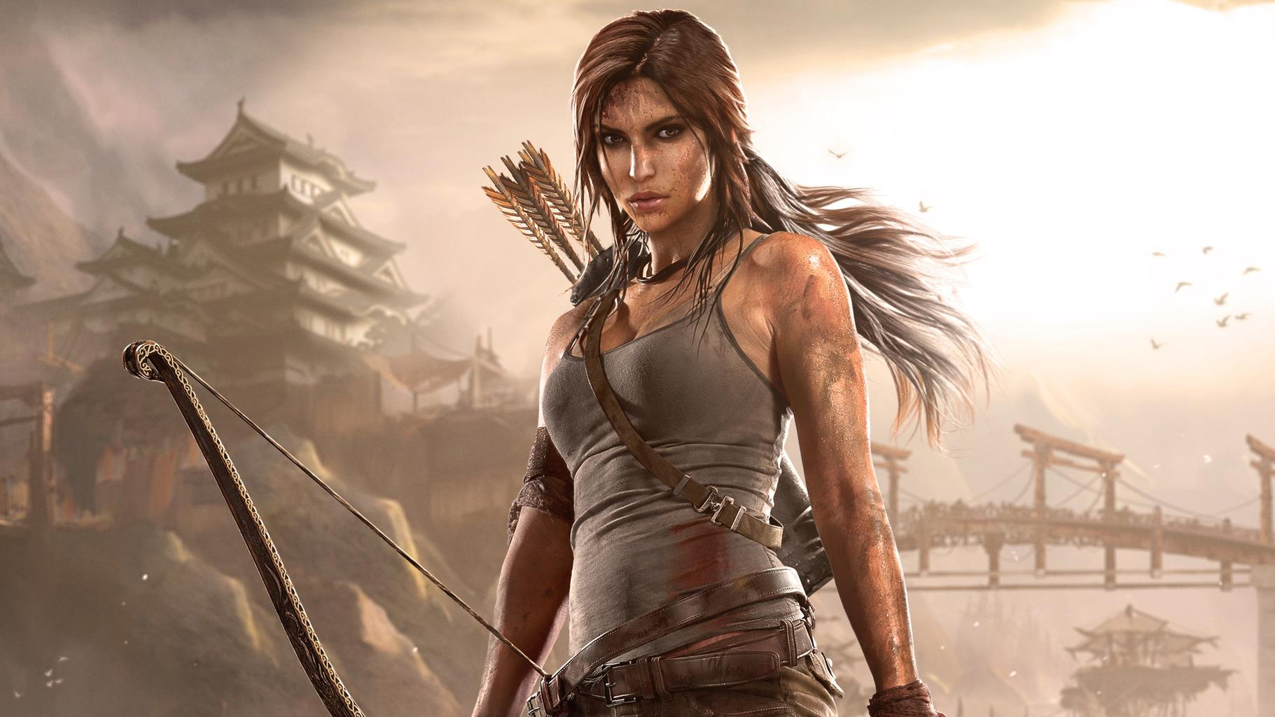
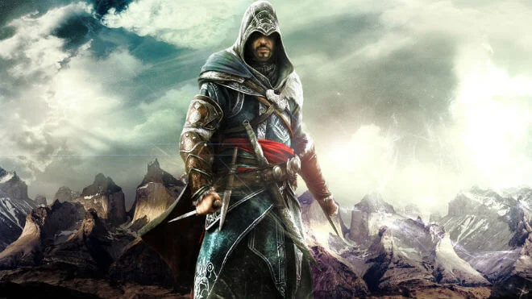
SIV871 Minor Project
Deep-Parzival
Kratos
Geralt
Game Character Recognizer
Sarthak Behera (2018CS10384)
Sai Sukruth Bezugam (2019EEY7521)
Ezio Auditore
Lara Croft

Slide 2
Reasons Behind Choosing Game Character dataset
Game Character dataset Source
Generalized Dataset.
Distinctive features for each character.
Human create characters try enhance human / animal like features.
Easy to find human subjects who can classify characters.
Web image search
Automated scraping

Slide 3
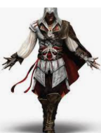
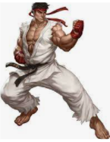

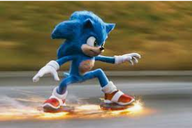
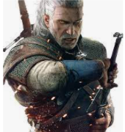
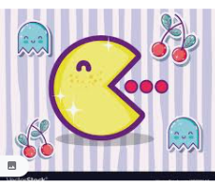

Characters Selected

Slide 4
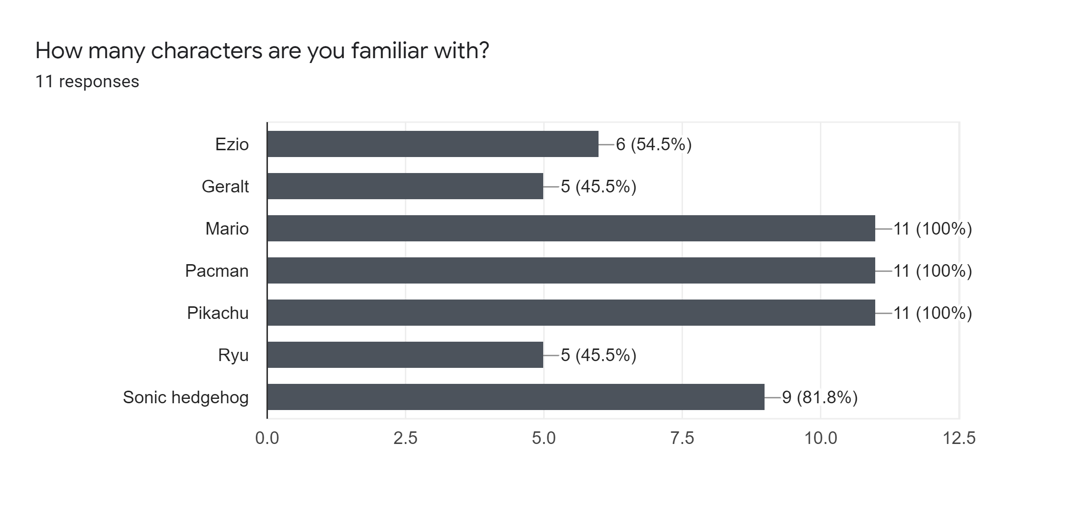
Characters Selection Reasons
Distinctive feature in each character.
To make sure network and human easily differentiate.
Few well popular characters (4) and Few partially known (3).
To understand if human works completely on previous knowledge, any bias in classification by Network.
Character similar to understand relatability factor in humans
Humans (3)
Animals (3)
Shape (1)

Slide 5
Dataset Specifications
Data is obtained by data-scraping from Google for each character name as “search keyword” with creative commons licence.
Data set is small with 100 images for each class.
We choose a random 80:20 split during training and validation.

Slide 6
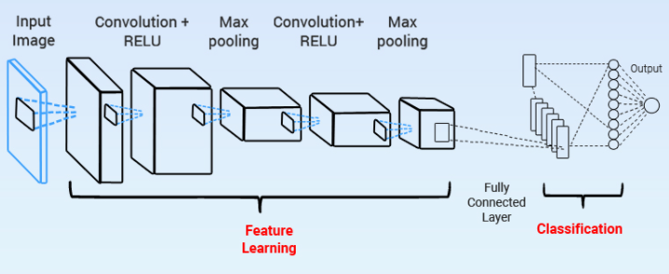
Image classification (Transfer Learning)
Fixed Weights
Trainable
Weights

Slide 7
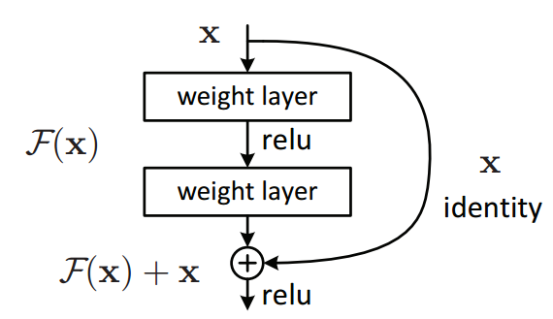
Network Architecture
We used Resnet for following reasons
Faster training due to residual connections
Compact weight matrix compared to VGG Net
Pretrained weights are available
Experiments Done
Transfer Learning on ImageNet weights
Training network with random weight matrix
Inclusion of Blur to no blur while training network, to understand learning in.

Slide 8
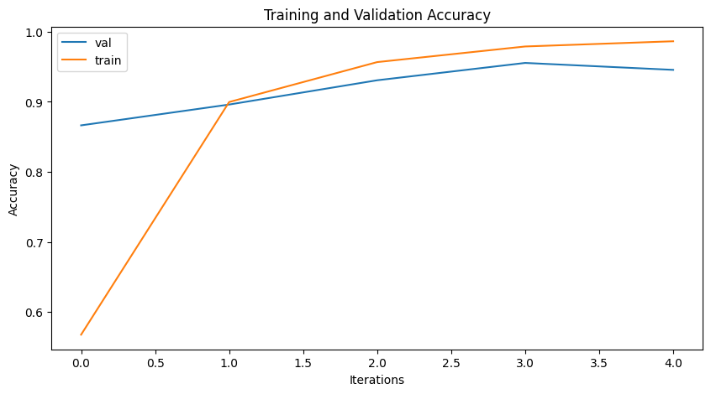
Resnet50 Transfer Learning
Even with 5 epochs, training and validation accuracy reached nearly 95%, thus pretrained network learnt a good feature space correspondence.
Highest Accuracy

Slide 9
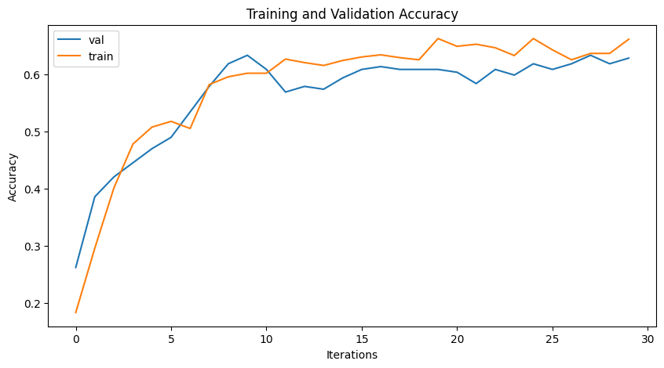
Resnet 50 with random weights
Lower accuracy
When weights are not pre-trained, training and validation accuracy barely reach above 60% even when model is run for 30 epochs. One may also observe some degree of overfitting.

Slide 10
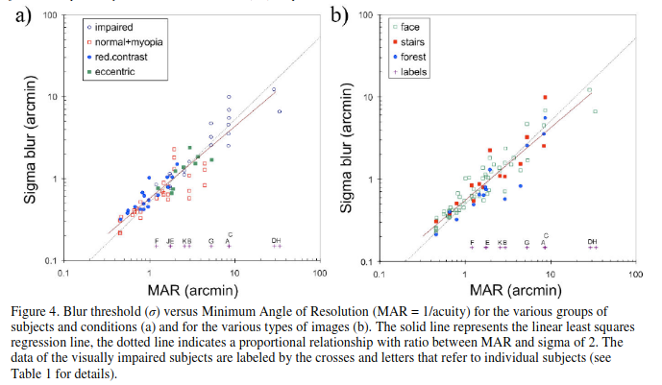
Graph from the paper Visualizing Vision Impairments by Hogervorst et. al.
This gave us idea about simulating blurring analogous to child vision development

Slide 11
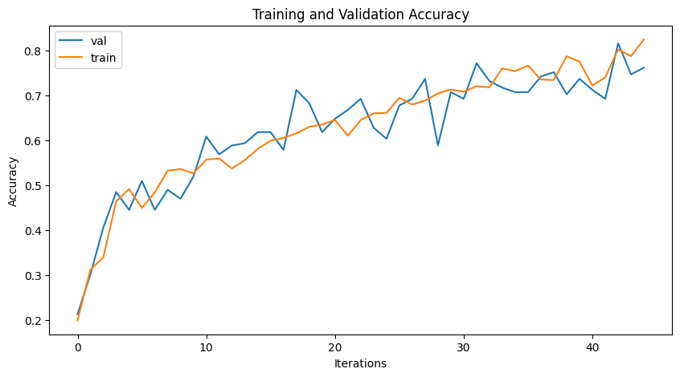
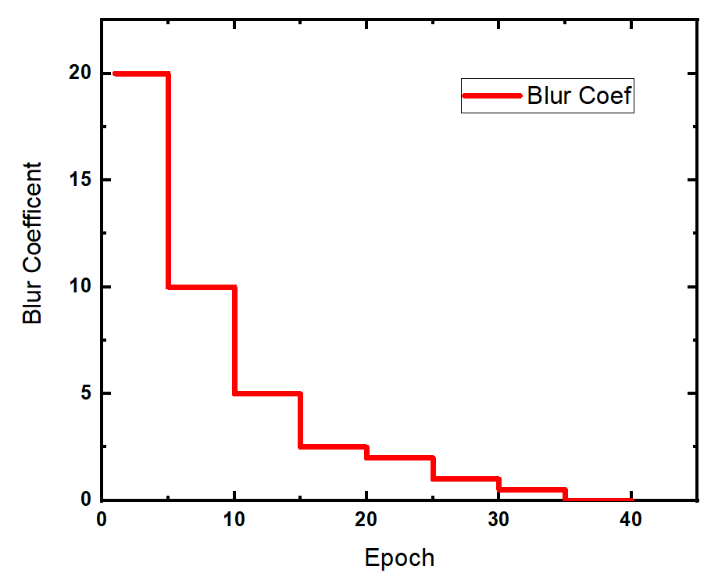
Resnet50 with Inclusion of Blur to no blur (Child vision Development model) in preprocessing pipeline
Better Learning and higher accuracy
Using a fresh resnet50 model and the pipeline resulted in accuracy frequently exceeding 80%.

Slide 12
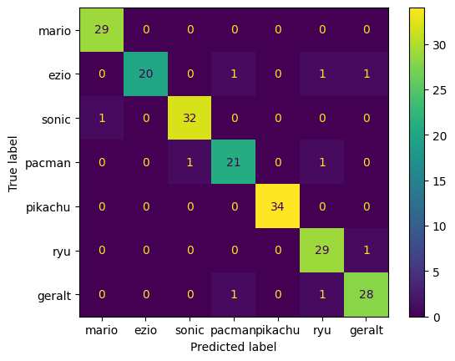
Classification Confusion Matrix
Highest error between human classes ezio and geralt.
Very less or no confusion between animal and human types of classes.
Similar trend observed in humans.

Slide 13
Human Accuracy
People were shown all the characters once and asked them how many of characters they aren't familiar. Matched our hypothesis.
Humans were expected to classify 10 images (7 correctly classified by the network and 3 misclassified by the network) and give information about their cues.
This experiment is done among individuals of 20-25 years using google sheets.
https://docs.google.com/forms/d/e/1FAIpQLScrYKs7CD4W-qrdONrlLZvSaGy0fyAgwKtuRULd4Nzs255xpA/viewform?usp=sf_link

Slide 14
Insights
Top 1 Human Accuracy = 96.33%
Top 2 Human Accuracy = 100%
Mismatch only occurred between Ezio or Geralt which were less known characters.
But Ryu was also less known character but was more similar to human, they were easily able to correlate and correctly classified

Slide 15

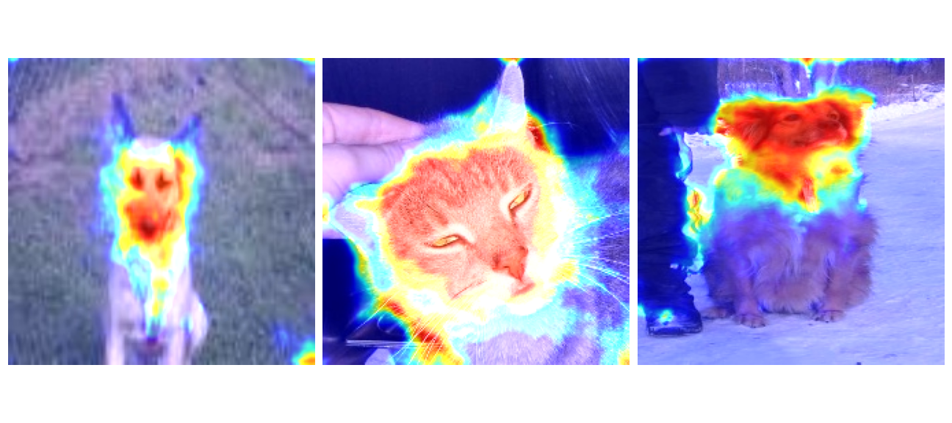
Trying to draw parallels to Human Vision and Deep Vision
Simple Questionnaire asking what was the most prominent feature helped to classify
Human Vision
Deep Vision
GradCam
[Selvaraju, Ramprasaath R., et al. "Grad-CAM: Visual Explanations from Deep Networks via Gradient-Based Localization. ICCV." (2016).]

Slide 16
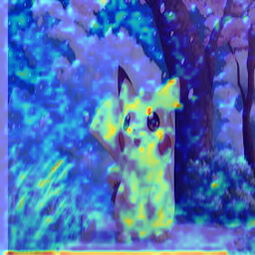
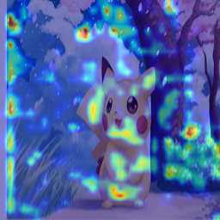
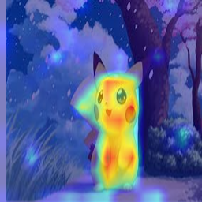
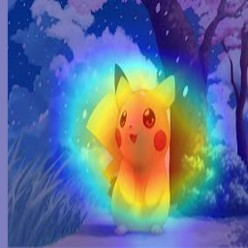
GradCam - Visualizing deep vision with backward gradient injection to network
Layer[-4] Layer [-3] Layer [-2] Layer [-1]
Finer Details to coarser details

Slide 17
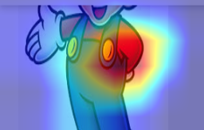

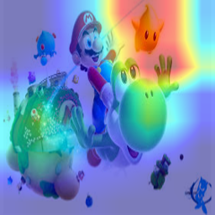
Cues from Humans were very interesting
Human Insights in seeing Mario
Uniform and his beard
Red dress with cap
Mustache
Red and Blue Dress
Cap 🧢
eyes, moustache
Distinct Color
Cap and Moustache, Plumber pants
Tummy, mustache and dress
His unique dress and chubby figure

Slide 18
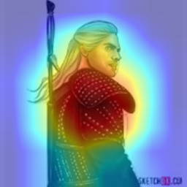
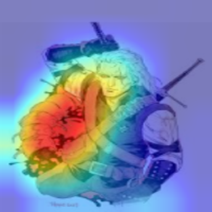
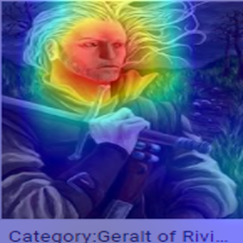
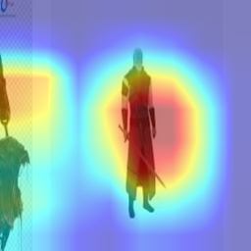
Cues from Humans Vs Computer vision model
Human Insights in seeing Geralt
Costume
Age
white hair, slightly aged persona
Swords
sword, outfit
Intricate features
Warrior face, blonde/white hair,
white hair and warrior-like dressing
silver hair and sword

Slide 19
GradCam - Visualizing deep vision with backward gradient injection to network
Layer[-4] Layer [-3] Layer [-2] Layer [-1]
Human Insights
Finer Details to coarser details

Slide 20
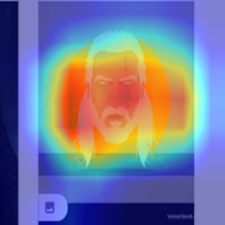
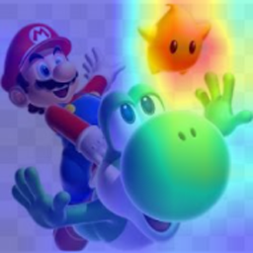
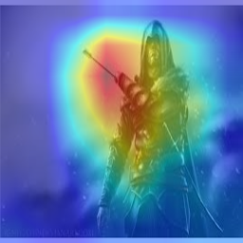
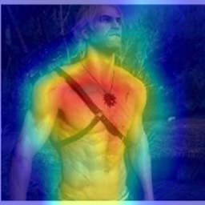
Some misclassified images

Slide 21
Conclusion
Human versus network accuracy to classify game characters.
The visual acuity development in child is extremely important for proper visual development as our pipelined structure was illustrated this fact when against the non-pipelined version.
The pipelined version still couldn’t match the pretrained model which might signify that child may have multimodal learning.
Drawing parallels between human and network vision cues through Grad cam analysis, we could observe human use objects associated with character to classify image, Network was using more coarser features.
P.S. Had an comprehensive learning from selecting a problem statement, creating an own dataset, understanding how network gets trained and child vision development, drew parallels between Human and Network vision.

